Slide 1

Elastic Block Store (EBS)

Slide 2
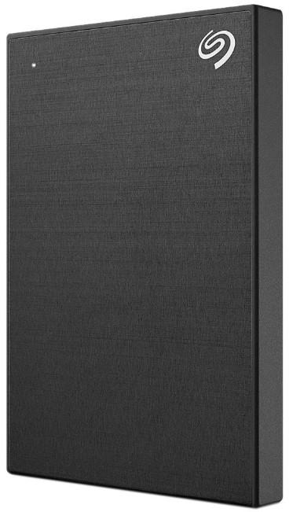

Simple Use-Case: External Hard Disk
External Hard Disk can be attached to the Workstation and detached whenever required (portable)
Depending on the use-case, you can buy external storage of different configuration based on size, performance and others.
Workstation

Slide 3


Understanding the Basics
Elastic Block Store (Amazon EBS) is a scalable, high-performance block-storage service designed for Amazon EC2.
These volumes can be attached and detached from EC2 instance.
Storage Volume
EC2 Instance

Slide 4
EBS is Network Storage
EBS volumes are attached to EC2 instance through Network.
There can be latency that might be involved.
1 volume attached
Network Mount
EC2 Instance
Elastic Block Store

Slide 5
Availability Zone Specific
You create an EBS volume in a specific Availability Zone, and then attach it to an instance in that same Availability Zone.
Cross Availability Zone based attachment is not supported.
1 volume attached
us-east-1a
us-east-1a

Slide 6
EC2 and EBS Attachment
One EC2 instance can be attached with multiple set of EBS volumes of different sizes.
10 GB
EC2 Instance
100 GB

Slide 7
Instance Store
Temporary Data

Slide 8

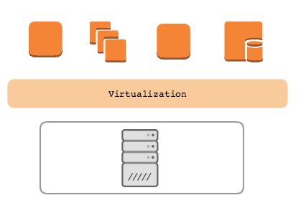



Revising EBS Architecture
In this type of architecture, the EBS volumes are mounted via the network to the EC2 instance.
When we stop and start the EC2, the VM might migrate to a different host altogether. Since EBS is mounted via the network, the challenge related to data does not arise.
Network
knowledge portal

Slide 9
What is Instance Store ?
AWS Instance Store provides temporary block storage volumes for use with EC2.
This storage is located on the disks that are physically attached to the host computer.
The size of instance store varies depending on your instance type.
knowledge portal

Slide 10

Important Points for Instance Store
Data in instance store is lost in the following situation:
The underlying disk drive fails.
The instance stops.
The instance terminates.
Instance store is included in the cost of EC2 instance, so they are quite cost-effective.
If planning to use instance store, make sure you backup your data to central storage places like S3.
knowledge portal

Slide 11
AWS Simple Storage Service (S3)
Unlimited Storage

Slide 12

Use Case - Storage Capacity
We all have some important data that needs to be reliably stored.
Most of us decides to store our data in external hard disk drives as a backup.
Important Folder
knowledge portal

Slide 13
Better Approach
In this approach, we decide to replicate the data in two different hard disk drives.
Downside:
Expensive Approach,
If you keep these disk in same location, there is a risk.
Important Folder
knowledge portal

Slide 14
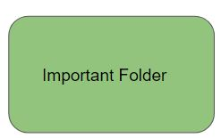
Best Approach
In this approach, we store the data in Cloud and let Cloud provider take care of backups.
Backups
Cloud Storage
Important Folder
knowledge portal

Slide 15


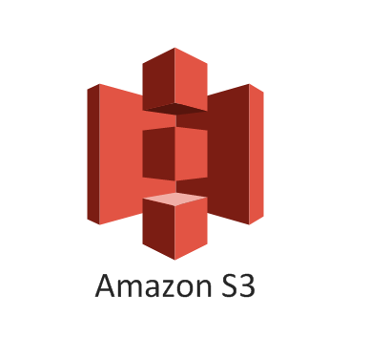
Cloud Storage Providers
There are multiple Cloud storage providers that are available.
Depending on your use-case, you can select one among them.
Cloud Storage

Slide 16
Introduction to S3
AWS Simple Storage Service (S3) is an object storage designed to store and retrieve any amount of data from anywhere
It is designed for 99.999999999% durability and 99.99% availability.
The aspect that makes AWS S3 so powerful are it’s associated features.
Versioning | Encryption | Logging
Transfer Acceleration | Cross Region Replication | Events
Requester Pays | Static Website Hosting | Tagging
knowledge portal

Slide 17
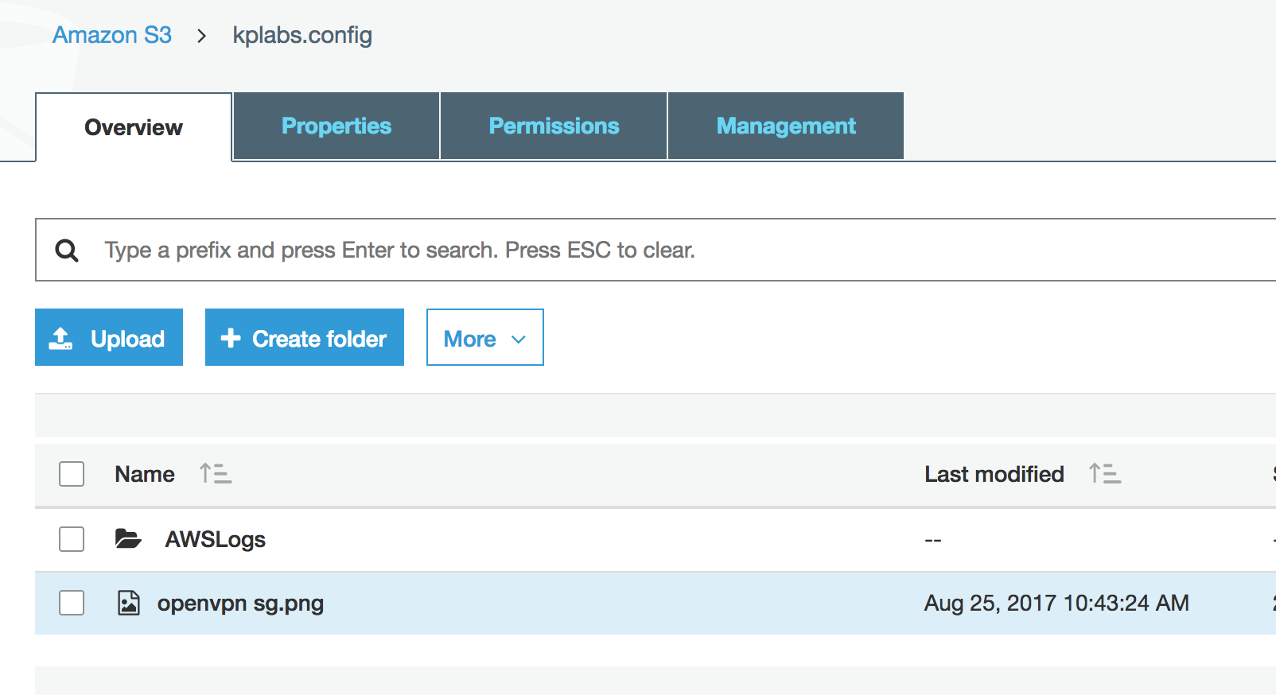
S3 Terminology
There are two important terminology in AWS S3 :
Buckets
Objects
Important Note: Bucket Names are unique across entire AWS Namespace.
knowledge portal

Slide 18
S3 Storage Classes
Cloud Storage is Saviour

Slide 19
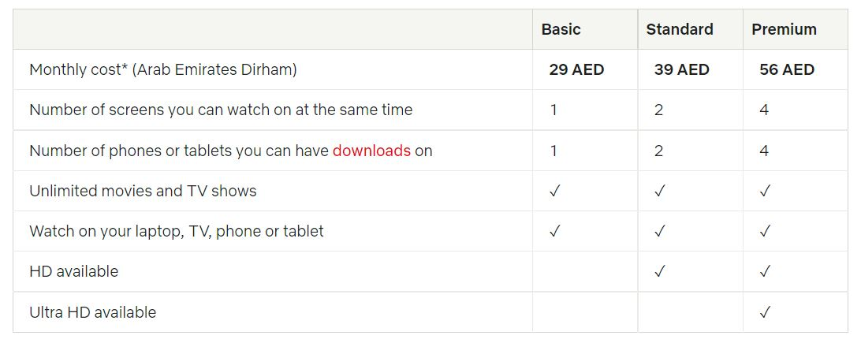

Use-Case - Netflix
Netflix offers various different subscription plans for various category of requirements.
Main Aim: Watch the Entertainment Content
knowledge portal

Slide 20
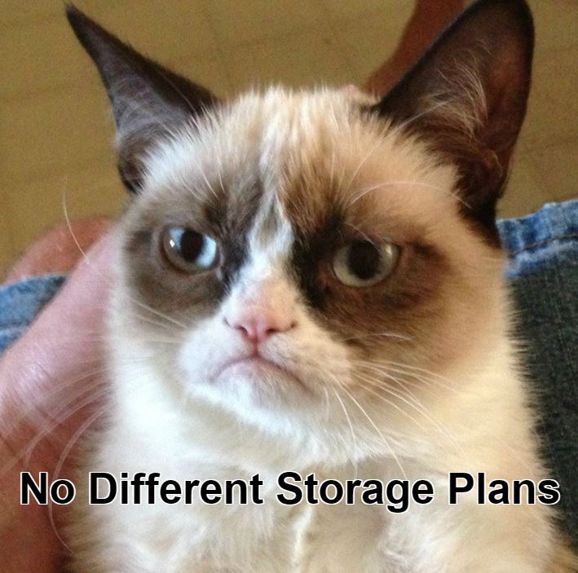
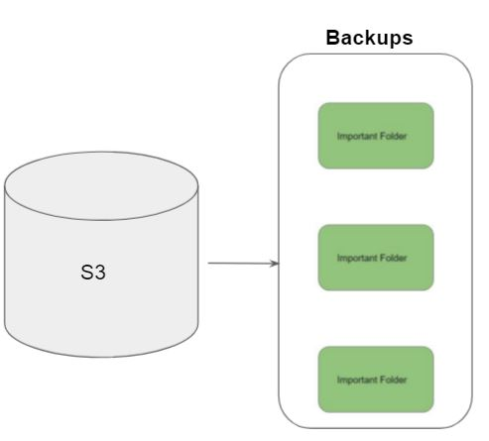
Initial Challenge - S3
AWS has millions of active customers.
Each customer might have different requirements for data storage.
Main Aim: Store Data.
knowledge portal

Slide 21
S3 Storage Classes
Amazon S3 offers a range of storage classes designed for different use cases.
Storage Classes | Description
S3 Standard | Offers high durability, availability, and performance object storage for frequently accessed data
S3 Standard-Infrequent Access | For data that is accessed less frequently, but requires rapid access when needed.
Amazon S3 Glacier | Low-cost storage class for data archiving
knowledge portal

Slide 22
AWS S3 Standard
S3 Standard offers high durability, availability, and performance object storage for frequently accessed data.
Designed for durability of 99.999999999% of objects ( eleven nines )
Example :-
If we have 10,000 files stored in S3 ( 11 nines durability ) then you can expect to lose one file every ten million years.
knowledge portal

Slide 23
AWS S3 Standard IA
S3 Standard-IA is for data that is accessed less frequently, but requires rapid access when needed.
Comparing storage cost of 1TB data stored in S3 based on accessibility patterns.
Criteria | Amazon S3 | Amazon S3 IA
Storage of 1TB Data | $23.44 | $23.50
50% storage accessed in last 30 days | - | $18.18
0% storage accessed in last 30 days | - | $12.80
knowledge portal

Slide 24
Amazon S3 Glacier
Glacier is meant to be for archiving and for storing long-term backups.
Ideally meant for data that needs to be archived for years without much requirement of access.
Criteria | Amazon S3 | Glacier
Storage of 1TB Data | $23.44 | $4.10
knowledge portal

Slide 25
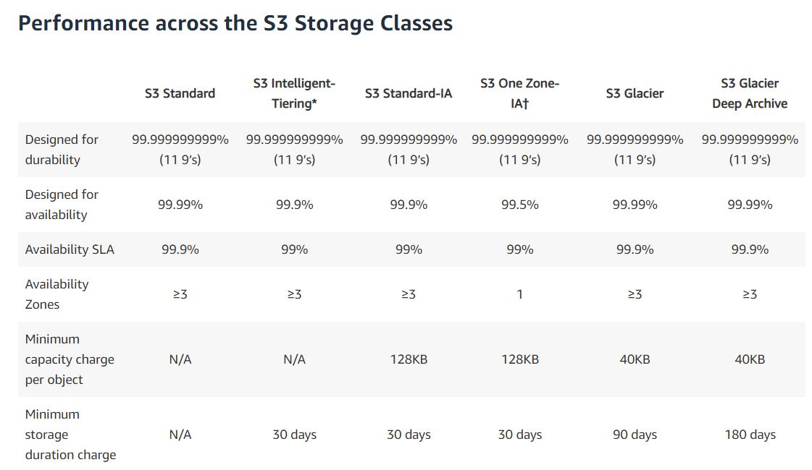
Multiple S3 Storage Classes

Slide 26
Durability vs Availability
Durability is percent ( % ) over one year period of time that the file which is stored in S3
will not be lost.
Availability is percent (%) over one year period of time that the file stored in S3 will
not be available.
Example :-
For Servers, Availability is one of the key metric and any minute of downtime is a loss.
However what happens if component of server itself fails and server goes down ?
knowledge portal

Slide 27
S3 Intelligent-Tiering
Smart Automated System

Slide 28
Overview of S3 Intelligent Tiering
The S3 Intelligent Tiering is primarily designed to optimize cost by automatically moving data to most cost-effective tier.
1TB of data stored in Standard S3 = $23.44
1TB of data stored in Standard IA = $12.80
Organization stores terabytes of data in S3.
It will be great if a solution automatically moves infrequent data to Standard IA.
knowledge portal

Slide 29
Overview of S3 Intelligent Tiering
The S3 Intelligent Tiering works by storing data in one of the two access tiers:
Frequent Access Tier (Costly)
Infrequent Access Tier (Much cheaper)
Frequent Access Tier
Infrequent Access Tier
knowledge portal

Slide 30
Overview of S3 Intelligent Tiering
The S3 Intelligent Tiering works by storing data in one of the two access tiers:
Frequent Access Tier (Costly)
Infrequent Access Tier (Much cheaper)
Frequent Access Tier
Infrequent Access Tier
knowledge portal

Slide 31
Overview of S3 Intelligent Tiering
Smart Automation System
Frequent Access Tier
Infrequent Access Tier
knowledge portal

Slide 32
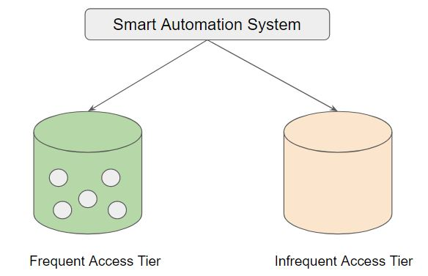
Revising S3 Intelligent Tiering
Amazon S3 monitors access patterns of the objects in S3 Intelligent-Tiering, and moves the ones that have not been accessed for 30 consecutive days to the infrequent access tier.
If an object in the infrequent access tier is accessed, it is automatically moved back to the frequent access tier.
A monthly monitoring and automation fee is charged at a per object level.
knowledge portal

Slide 33
S3 Storage Class - One Zone IA
Back again!

Slide 34
Understanding the Basics
Storage classes like Standard S3, Standard IA stores the data in minimum 3 availability zones.
Due to this, the overall cost per of storage is increased with such architecture.
Availability Zone 1
Availability Zone 2
Availability Zone 3
knowledge portal

Slide 35
Overview of One Zone IA
S3 One Zone-IA stores data in a single AZ and costs 20% less than S3 Standard-IA.
It’s a good choice for storing secondary backup copies of on-premises data or easily recreatable data.
Data will be lost in-case of availability zone destruction.
Availability Zone 1
knowledge portal

Slide 36
Pricing Comparison
Overview of Pricing comparison between storage classes:
1TB of data stored in Standard S3 = $23.44
1TB of data stored in Standard IA = $12.80
1 TB of data stored in One Zone IA = $10.24
knowledge portal

Slide 37
S3 Storage Class - Glacier
Back again!

Slide 38
Overview of Glacier
Amazon S3 Glacier is a low-cost, cloud-archive storage service that provides secure and durable storage for data archiving and online backup.
Storage Class
Glacier
Glacier Deep Archive
knowledge portal

Slide 39
Pricing Comparison
Storage Class & Data Storage | Pricing
1 TB Data stored in S3 Standard | $23.44
1 TB Data stored in One Zone IA | $12.80
1 TB Data stored in Glacier | $4.10
1 TB Data stored in Glacier Archive | $1.02
knowledge portal

Slide 40
Glacier vs Glacier Deep Archive
To keep costs low, Amazon S3 Glacier provides three options for access to archives, from a few minutes to several hours.
Glacier Deep Archive provides two access options, which range from 12 to 48 hours
Storage Class | Expedited | Standard | Bulk
Amazon S3 Glacier | 1–5 minutes | 3–5 hours | 5–12 hours
S3 Glacier Deep Archive | Not available | Within 12 hours | Within 48 hours
knowledge portal

Slide 41
Important Note
Amazon S3 Glacier for archiving data that might infrequently need to be restored from minutes to few hours.
S3 Glacier Deep Archive for archiving long-term backup cycle data that might infrequently need to be restored within 12 hours
knowledge portal

Slide 42
Static Website Hosting in S3
A Great Feature

Slide 43

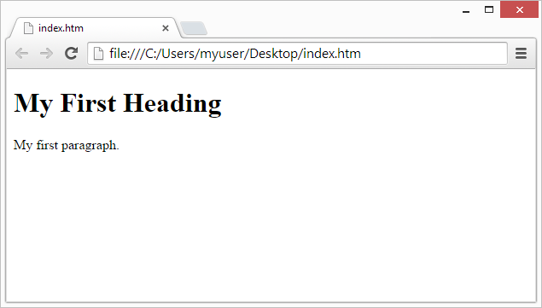


Challenges with Static Websites
If you want to host a basic static website, you need to create and manage the entire server infrastructure on a cloud provider.
EC2
SSM
Static Website
ELB
knowledge portal

Slide 44

Static Website Hosting in S3
With Amazon S3, you can now host static websites directly through S3.
S3 Bucket
Static Website
knowledge portal

Slide 45
Static Vs Dynamic Websites
On a static website, individual webpages include static content. They might also contain client-side scripts.
Dynamic website relies on server-side processing, including server-side scripts such as PHP, JSP, or ASP.NET.
knowledge portal

Slide 46
S3 Lifecycle Policies
S3 is Awesome

Slide 47
Overview of Lifecycle Policies
Organizations tends to keep terabytes of data in S3. For such cases, cost becomes a primary factor.
Storing the data directly into the AWS S3 Standard is not the best approach. Depending on the access patterns, criticality of the data, data should be transitioned to appropriate storage class.
We can store 1 months of logs in Amazon S3 Standard.
Move the logs older than 1 month to S3 Standard-IA
Move the logs older than 6 months to Glacier
knowledge portal

Slide 48


Transition Actions
After 30 days
After 60 days
video.mp4
video.mp4
video.mp4
S3 Standard-IA
Glacier
S3 Standard
knowledge portal

Slide 49
S3 Versioning
Versioning in Object Storage

Slide 50
Challenge 1 - Multiple Object with Same Key
Store File
a.txt
a.txt
a.txt
a.txt
Storage
knowledge portal

Slide 51

Challenge 2 - Accidental Deletion of Objects
Delete File
a.txt
Storage
knowledge portal

Slide 52
Versioning in Object Storage
Versioning allows users to keep multiple variants of an object in the same S3 bucket.
You can use versioning to preserve, retrieve, and restore every version of every object stored in your Amazon S3 bucket.
a.txt
a.txt
a.txt
a.txt
Storage
knowledge portal

Slide 53
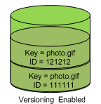
Important Pointers for Versioning
Once you version enable a bucket, it can never return to an unversioned state. You can, however, suspend versioning on that bucket.
The versioning state applies to all (never some) of the objects in that bucket.
knowledge portal

Slide 54
S3 Transfer Acceleration
Least Latencies

Slide 55



Overview of S3 Transfer Acceleration
S3 Transfer Acceleration allows users to accelerate data uploads from all over the world to centralized S3 bucket.
The transfers are accelerated by routing data to the closest edge location.
Optimized Network
STA Path
CloudFront Edge
S3 Bucket
User
Direct S3 Upload

Slide 56





Edge Locations
knowledge portal

Slide 57

S3 Transfer Acceleration
knowledge portal

Slide 58
Intro to Amazon SQS
Message Queuing Service

Slide 59

Use-Case: Restoring Image Application
Medium Corp is designing an application that will enhance and restore the images that users submit through the online portal.
knowledge portal

Slide 60

Current Architecture
The overall architecture involves two components:
Image Gatherer - Takes the Images from the user via Upload button.
Imager Enhancer - Receives the Image from Image Gatherer.
Send Image
Image Gatherer
Image Enhancer
knowledge portal

Slide 61
Challenges
Due to popularity of the application and huge traffic spike, Medium Corp has decided to add more image enhancer servers.
server-a | 10.77.2.5
server-b | 10.66.0.10
server-c | 192.168.0.2
server-d | 10.66.10.10

Slide 62
Better Architecture
One of the main function of message queue service is to take message from a Publisher and forward that to a consumer.
The queue stores these messages internally.
Send to Queue
Take from Queue
Highly-Available Queue
knowledge portal

Slide 63
Introduction to SQS
Amazon SQS is a fast reliable, scalable, and fully managed message queuing service.
Amazon SQS makes it simple and quiet cost effective to decouple the components of a specific application.
Send to Queue
Take from Queue
SQS
knowledge portal

Slide 64
Tightly Coupled Systems
Components of system architecture directly communicate with each other and have hard-dependency on each other.
Producers
Consumers
knowledge portal

Slide 65
Loosely Coupled System
Components of system architecture that can process the information without being directly connected.
Producers
Consumers
knowledge portal

Slide 66
Storage Gateway
Hybrid Storage

Slide 67
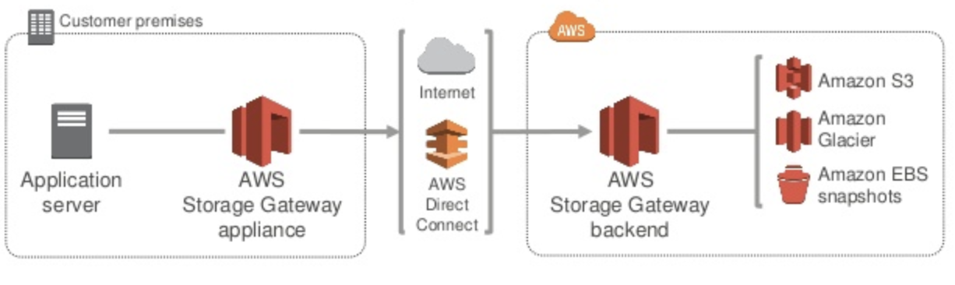
Introduction
AWS Storage Gateway is a hybrid storage service that allows the on-premise application to easily use the cloud storage
knowledge portal

Slide 68
Storage Gateway
Storage Gateway appliance uses standard storage protocols like NFS, iSCSI which the application connects to and stores the data.
The other end of storage gateway connects to AWS storage services like S3, Glacier and EBS Snapshots
knowledge portal

Slide 69
Storage Gateway Configuration
There are three different configuration available :
Gateway Stored Volume
Gateway Cached Volume
Gateway-virtual tape library
knowledge portal

Slide 70
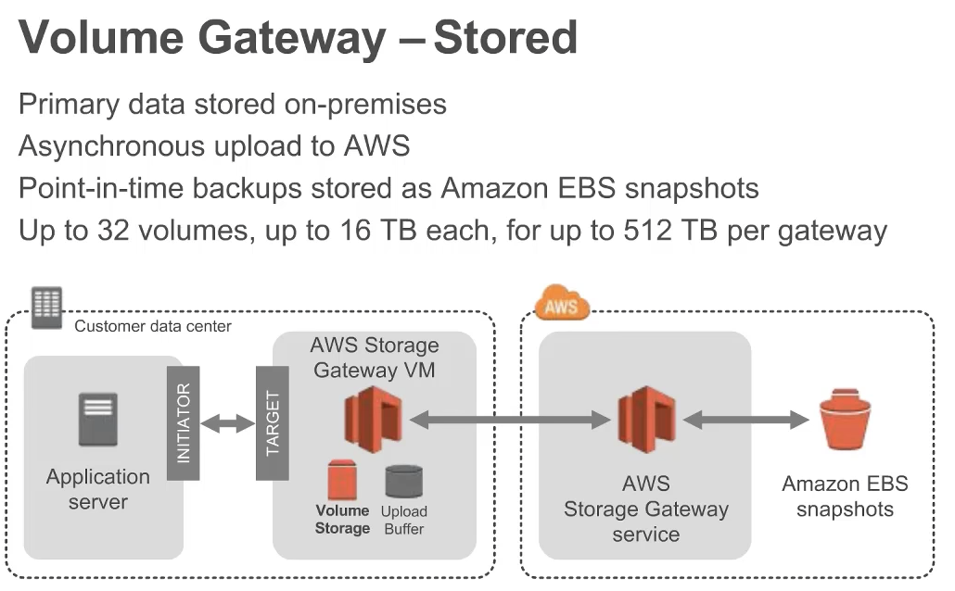
Gateway Stored Volumes
Gateway Stored Volume :
Stores primary data locally while asynchronously backing up data to AWS.
knowledge portal

Slide 71
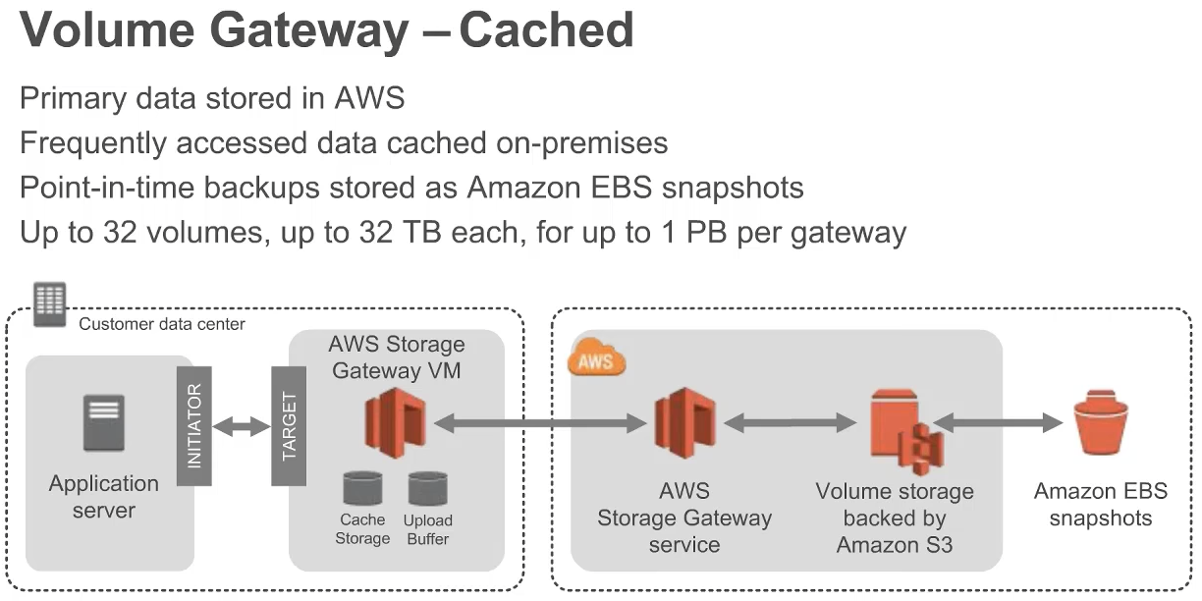
Gateway Cached Volumes
Gateway Stored Volume :
Data is stored primarily on AWS S3 with cache of recently read or written data stored locally in the on-premise server.
knowledge portal

Slide 72
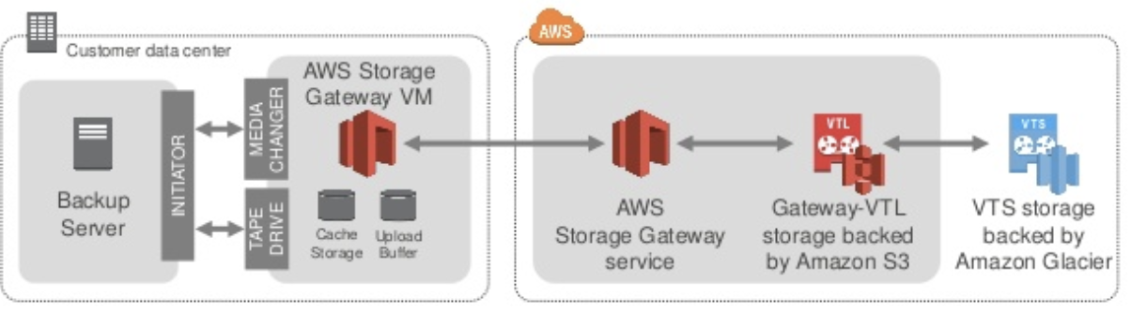
Gateway-virtual tape library
Gateway-virtual tape library
Virtual tapes stored in S3 with frequently accessed data stored on-premise.
knowledge portal

Slide 73


Tape based storage
Tape backup is practice of periodically copying data from primary storage device to a tape cartridge so data can be recovered if there is any data crash or failure on primary device.
Tape solutions remains most cost effective solution till date.
knowledge portal

Slide 74
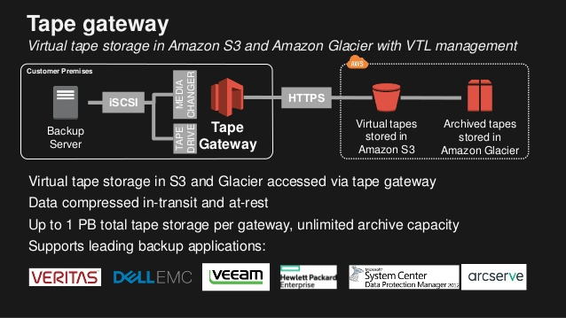
VTS and VTL
knowledge portal

Slide 75
CloudWatch Logs
Logging Yet Again!

Slide 76

Challenges with Logging
A server can contain a lot of log files, from system logs to the application logs.
During debugging, it is important to have log files at hand.
This means in default case; you need to give access to the server to an individual who wants to debug.
file.log
log line 01 - GET request
log line 02 - PUT request
log line 03 - DELETE
log line 04 - PATCH
log line 05 - POST
log line 06 - PUT request
knowledge portal

Slide 77
Disadvantage of the Approach
Access must be given to the server to the developers.
If the server gets terminated, the logs are lost.
No way to set up an alarm on certain conditions or create complex filters.
file.log
log line 01 - GET request
log line 02 - PUT request
log line 03 - DELETE
log line 04 - PATCH
log line 05 - POST
log line 06 - PUT request
knowledge portal

Slide 78
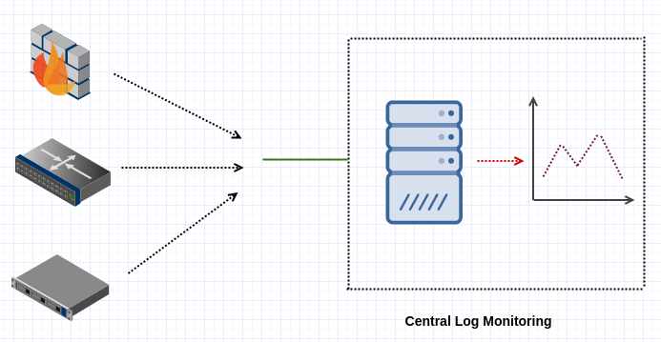
Better Way
We create a Central Log Server.
We push the log files from individual systems to Central Log Server.
knowledge portal

Slide 79
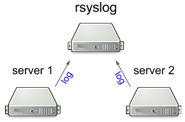
Centralized Log Management
There are multiple approaches to log the data centrally.
Linux comes with a default logging daemon called Rsyslog.
Commercial Log monitoring solutions like Splunk, ELK, can be used.
Services like AWS CloudWatch Logs also provides basic capabilities.
knowledge portal

Slide 80

CloudWatch Logs
CloudWatch Logs can be used to monitor, store, and access your log files from Amazon Elastic Compute Cloud (Amazon EC2) instances, AWS CloudTrail, Route 53, and other sources.
It is a highly-available scalable service.
Amazon CloudWatch
knowledge portal

Slide 81
Steps - CloudWatch Logs
There are three steps required to set up CloudWatch Logs with EC2.
Create an IAM role with appropriate policy.
Install CloudWatch Logs Agent.
Modify the configuration file to associate appropriate log files.
Amazon CloudWatch
knowledge portal

Slide 82
Amazon Elastic File System (EFS)
Network Attached Storage

Slide 83


Overview of Elastic File System
Amazon Elastic File System (Amazon EFS) provides a simple, serverless, set-and-forget elastic file system for use with AWS Cloud services and on-premises resources.
It is built to scale on demand to petabytes without disrupting applications, growing and shrinking automatically as you add and remove files
Mount
Elastic File System
EC2
knowledge portal

Slide 84



Attachment to Multiple Targets
Multiple compute instances, including Amazon EC2, Amazon ECS, and AWS Lambda, can access an Amazon EFS file system at the same time, providing a common data source for workloads.
Elastic File System
knowledge portal

Slide 85
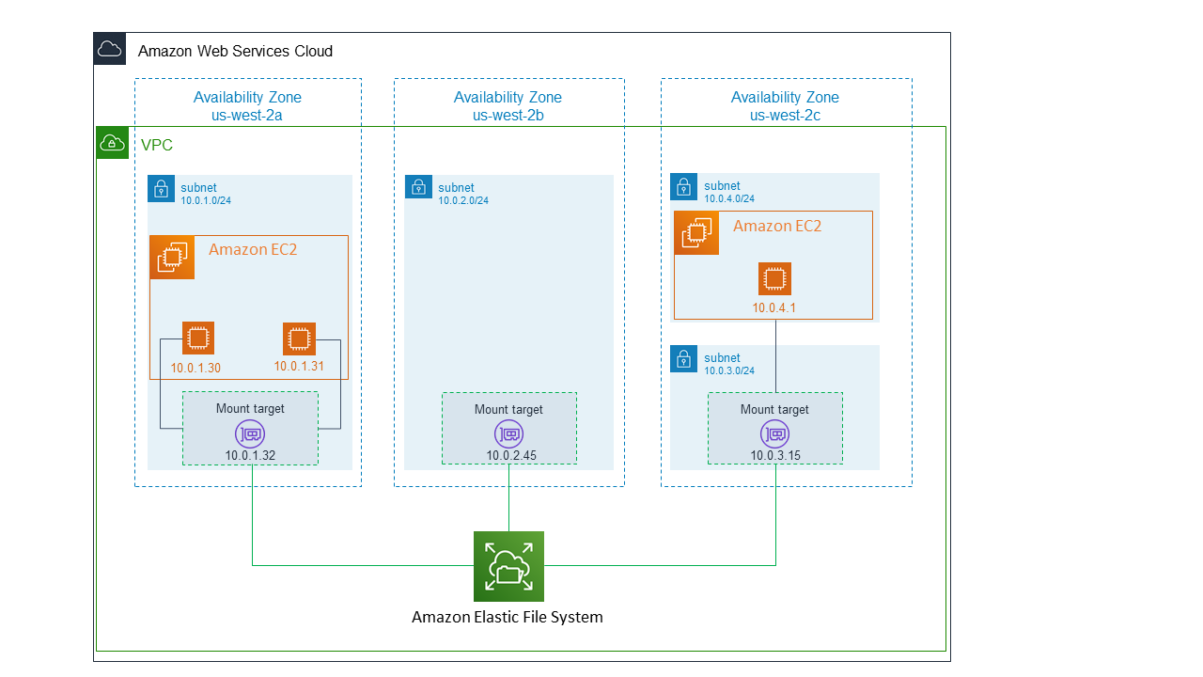
Understanding EFS Architecture
To access file system from instance inside the VPC, we need to create mount target in the VPC.
knowledge portal

Slide 86



Network File System
Network File System (NFS) is a networking protocol for distributed file sharing.
EFS uses the Network File System version 4 (NFS v4) protocol
Mount
Client
NFS Server
knowledge portal

Slide 87
Pricing Considerations
AWS EFS is expensive when compared to other storage options like EBS, S3.
Consideration | Pricing
1 TB EFS with 80% frequently accessed data | $250
1TB EBS Storage | $102
1 TB of S3 Storage | $24
knowledge portal

Slide 88
Important Pointers
If performance is your concern, always prefer EBS.
EFS can even be accessed from on-premise datacenter using an AWS Direct Connect or AWS VPN connection.
With Amazon EFS, you pay only for what you use per month.
knowledge portal

Slide 89
Amazon Kinesis
Streaming Data

Slide 90
Basics of Streaming Data.
Streaming data is the continuous flow of data generated by various sources
Sensor 1
Processing Store
Sensor 2
Sensor 3
knowledge portal

Slide 91

Examples of Streaming Data
A financial institution tracks changes in the stock market in real time and adjust it’s portfolio accordingly.
A media publisher streams billions of clickstream records from its online properties
knowledge portal

Slide 92
Challenges with Working of Streaming Data
Streaming data processing requires two layers: a storage layer and a processing layer.
The storage layer needs to support record ordering and strong consistency, replayable reads and the processing layer is responsible for consuming data from the storage layer, running computation on that data and many other tasks.
Storage Layer
Processing Layer
knowledge portal

Slide 93
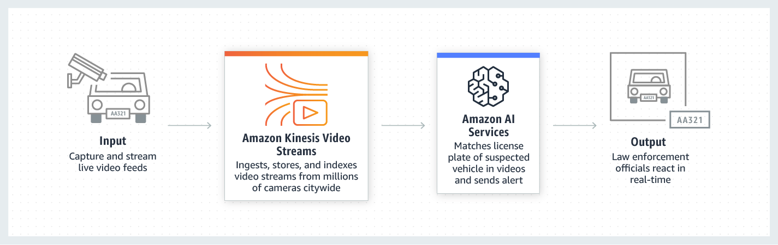
Basics of Amazon Kinesis
Amazon Kinesis makes it easy to collect, process, and analyze real-time, streaming data so you can get timely insights and react quickly to new information.
Amazon Kinesis offers key capabilities to cost-effectively process streaming data at any scale
knowledge portal

Slide 94
3 entities
There are 3 entities in this kind of use case:
Producer, Stream Store, Consumer
Amazon Kinesis
Consumers
Producers
knowledge portal

Slide 95

AWS Snowball Family

Slide 96
Understanding with Use-Case
Organization A has hosted all of it’s storage infrastructure in data-center.
Total Storage: 500 TB.
They have now decided to use S3 due to the benefits that it provides.
Bandwidth | Transfer Time
100 Mbps | 510 days.
500 Mbps | 101 days
1 Gbps | 50 days

Slide 97

AWS Snowball Family
Allows customers to Accelerate moving offline data or remote storage to the cloud
Send Storage Device
Customer
AWS Internal Network
AWS Team
Ship Back Device

Slide 98
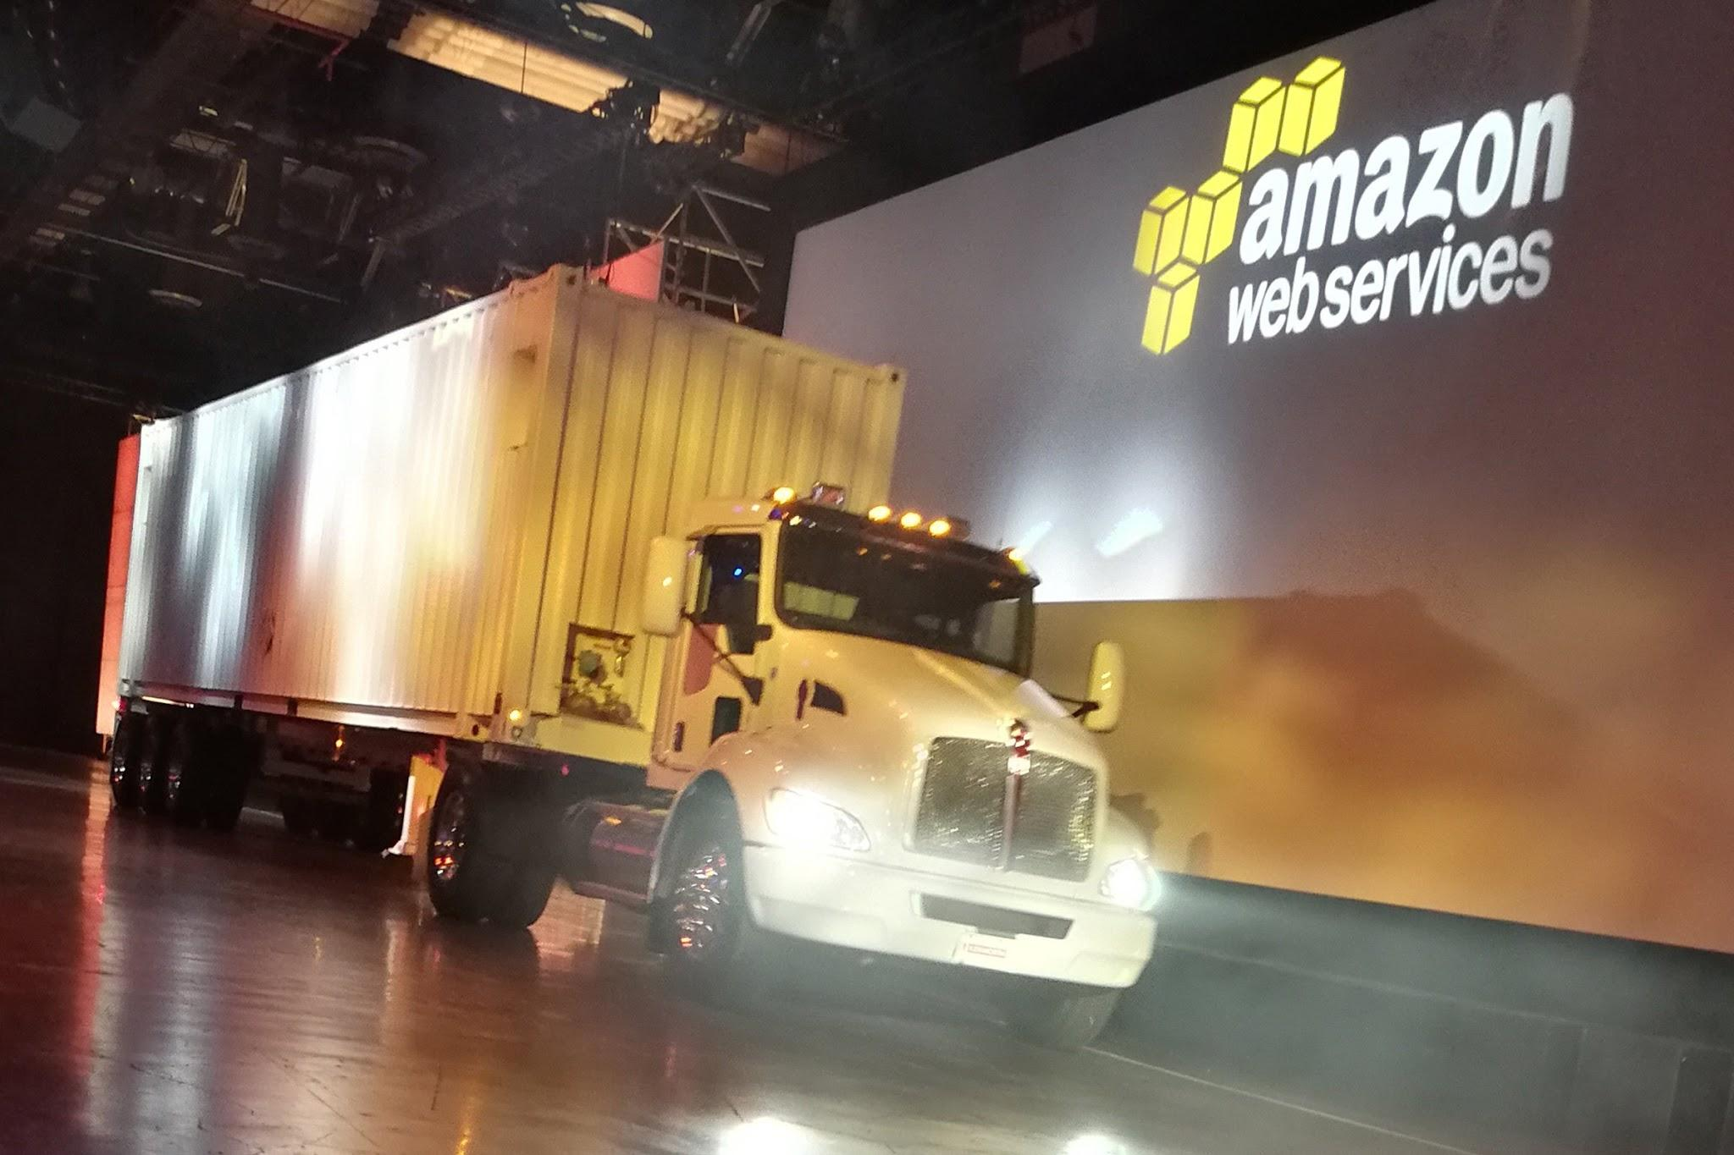
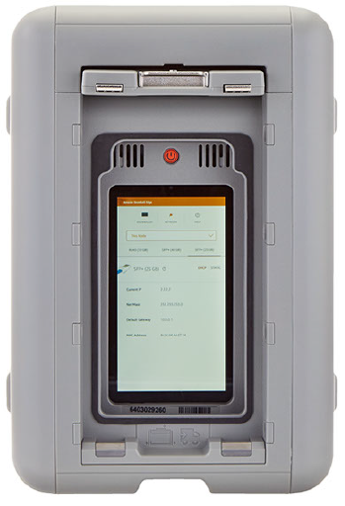
How the Storage Devices Look
Snowball Edge
Snowmobile

Slide 99


Edge Computing Functionality
These devices can also come with edge computing capabilities.
This means, you can run your applications in EC2 instances in the devices so that you can work in edge environments with limited connectivity.
Process data locally (Image/ Video Processing, Machine Learning etc)

Slide 100

Snowcone
AWS Snowcone is a small, rugged, and secure device offering edge computing, data storage, and data transfer on-the-go, in severe environment with little or no connectivity.
Can carry in backpack, drones and others.
8 TB of usable storage

Slide 101
Snowball Edge
AWS Snowball Edge is a type of Snowball device with on-board storage and compute power for select AWS capabilities
Available in Multiple Storage Capacity like 100 TB, 40 TB and others.

Slide 102
Snowball Edge
Device | Description
Snowball Edge Storage Optimized (for data transfer) | This option has a 100 TB (80 TB usable) storage capacity.
Snowball Edge Storage Optimized (with EC2 compute functionality) | This option has up to 80 TB of usable storage space, 24 vCPUs, and 80 GB of memory for compute functionality
Snowball Edge Compute Optimized | Most compute functionality, with 104 vCPUs, 416 GB of memory, and 28 TB of dedicated NVMe SSD for compute instances.
Snowball Edge Compute Optimized with GPU | Identical to the Compute Optimized option, except for an installed GPU

Slide 103
AWS Snowmobile
AWS Snowmobile moves extremely large amounts of data to AWS.
Transfer up to 100 PB per Snowmobile, a 45-foot-long ruggedized shipping container pulled by a semi-trailer truck.

Slide 104
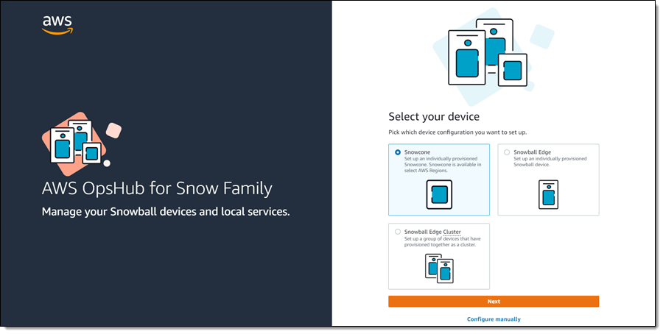
AWS OpsHub
AWS OpsHub is a graphical user interface you can use to manage your AWS Snowball devices.

Slide 105

AWS Backup

Slide 106





Understanding with Use-Case
AWS has lots of services where data can be stored.
For production environment, data backup is one of the critical task.
Taking backup at individual service level can take lot of time and require customization.
RDS
DynamoDB
S3
EFS

Slide 107
Introducing AWS Backup
AWS Backup is a fully-managed service that allows customers to configure backup policies in one central place.
AWS Backup
Backup
Backup
RDS
DynamoDB
S3
EFS

Slide 108
Benefits of using AWS Backup
Easily create backup rules for daily, monthly backups.
Backup Process is automated at a scheduled time.
Supports Cross-Region, Cross-Account Backups.
AWS Backup can back up on-premises Storage Gateway volumes and VMware virtual machines
Supports Retention Period that tells how long to store backup.

Slide 109


Join us in our Adventure
kplabs.in/twitter
Be Awesome
kplabs.in/linkedin

